Slide 1


Neural Adaptive Video Streaming with Pensieve
Hongzi Mao
Ravi Netravali Mohammad Alizadeh
Notes:
I’m going to talk about neural adaptive video streaming with Pensieve. This is a joint work with Ravi and Mohammad from MIT.

Slide 2
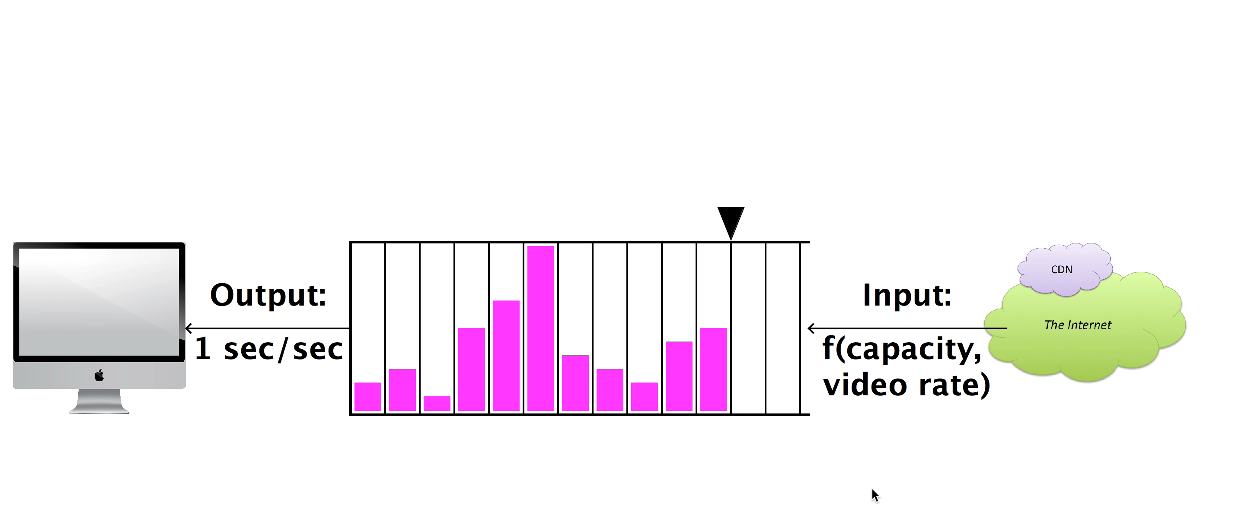






Dynamic Streaming over HTTP (DASH)
Request:
next video chunk at bitrate r
Output
1 sec/sec
Input
Response:
video content
bitrate
1 sec
video
content
Video Client
Video Server
Adaptive Bitrate (ABR)
Algorithms
bitrate
Animation borrowed from Te-Yuan Huang (SIGCOMM ‘14) http://conferences.sigcomm.org/sigcomm/2014/doc/slides/38.pdf
Notes:
The main framework to improve the quality of experience is dynamic streaming over HTTP or DASH. It's a very standard framework and I will give an overview of how it works.
To load a video, a video client periodically requests individual chunk of video from a video server. Each chunk represents several seconds of video and can be requested at one of several bitrates. As the video chunks are downloaded, they are stored in a playback buffer. In this abstract figure, each pink bar represents a video chunk in the buffer. The width of the bar is 1 second of the video and the height indicates the bitrate. The higher bitrate corresponds to higher resolution or higher quality of the video.
As the video is playing, the playback buffer is continually drained at a fixed rate since the user watches videos in ‘real time’, but the buffer will be populated at a variable rate, depending on the requested bitrate and network condition.
[play video]
This can become problematic if the chunks we request have higher bitrates than the network can support, therefore chunks are being drained faster than they are enqueued -- this ultimately leads to an empty buffer and thus a rebuffering period.
To prevent issues like this, video players use Adaptive Bitrate Algorithms, or ABR algorithms. These algorithms decide both when and at which bitrate to download each video chunk.
[click] Specifically, these algorithms choose among a few available bitrates adaptively depending on the network and playback buffer condition.
Because of that, these algorithms have a large impact on quality of experience.

Slide 3
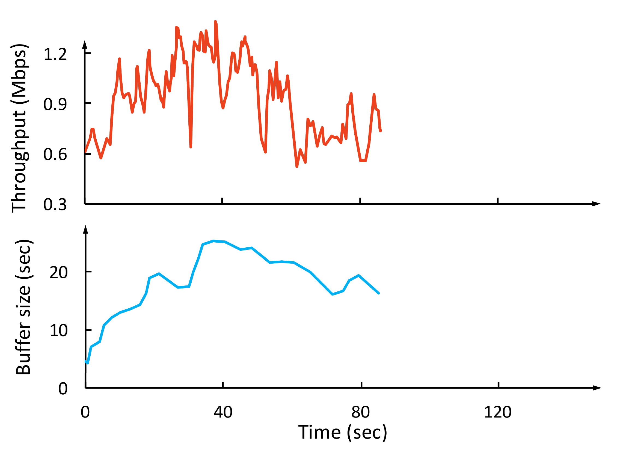
Why is ABR Challenging?
Throughput
Network throughput is variable & uncertain
Throughput
Bitrate
(Mbps)
Conflicting QoE goals
Bitrate
Rebuffering time
Smoothness
Video bitrate
Buffer size
(sec)
Cascading effects of decisions
Notes:
With this context, now let’s look at why designing ABR algorithms is so challenging? Let me use this example. Say we have streamed a video for a while..
Now at this point, how would the future throughput look like? it go higher, or it could could remain steady for a while and then drop, in fact it can be one of the many many possibilities -- past throughput observations cannot accurately predict what will happen exactly . It’s very challenging to select a bitrate that adapt to this noisy cloud of future possibilities.
Next, in practice, there’s tension and tradeoff among multiple conflicting QoE goals. People don't simply just want higher quality, they don't want rebuffering, and no bitrate fluctuations. However, selecting higher bitrates could result in rebuffering if there’s no enough playback buffer.
Finally, the bitrate decision for the next chunk can affect the decisions in the future. For example, using a high bitrate at the current time may deplete the video buffer, which leaves little cushion to deak with the risk rebuffering in case of network fluctuations. So, ABR algorithms must plan for the future.

Slide 4

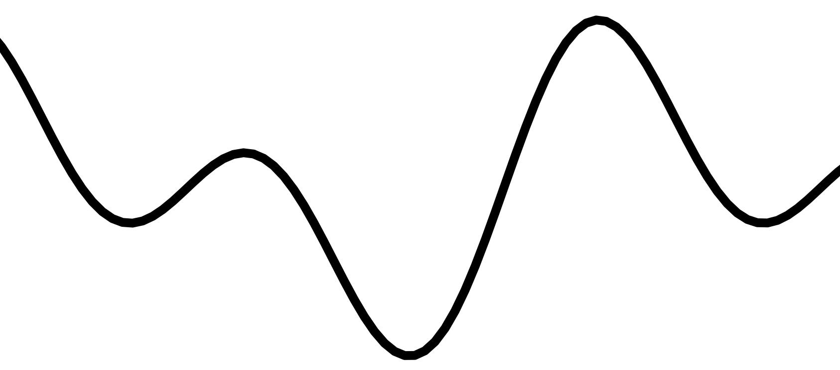


Our Contribution: Pensieve
bandwidth
ABR agent
bitrates
240P
bit rate
480P
720P
buffer
720P
1080P
First network control system using modern “deep” reinforcement learning
Delivers 12-25% better QoE, with 10-30% less rebuffering than previous ABR algorithms
Tailors ABR decisions for different network conditions in a data-driven way
network and video measurements
Pensieve learns ABR algorithm automatically through experience
Notes:
In this work, we built Pensieve, a system that uses reinforcement learning to learn an ABR algorithm automatically through experience. Pensieve represents the ABR algorithm as a neural network, that takes as input the observation from video client and output the bitrate decision for the next video chunk. It trains this neural network using data from a large number of video streaming sessions in actual network conditions.
[Click]
Our contribution with Pensieve, is that, to our knowledge, this is a first network control system that uses modern "deep" reinforcement learning techniques.
It outperforms existing ABR algorithms substantially, improving the quality of experience by 12-25%, with 10-30% less rebuffering over the best previous schemes in realistic network conditions.
We found that Pensieve is able to achieve this performance fundamentally because it learns rules for ABR that are specifically tailored for the underlining network characteristics.
Further, in building Pensieve, we learned several lessons about using deep reinforcement learning for network control systems. We believe these techniques are very powerful and can be applied to many other such problems, therefore I will share a few lessons that we learned near the end of this talk.

Slide 5
Example: Model Predictive Control
Solution: learn from video streaming sessions
in actual network conditions
t
t + T
Throughput
maximize QoE (t, t + T)
subject to system dynamics
Throughput
Bitrate
(Mbps)
Conservative Throughput
Prediction
Video bitrate
Buffer size
(sec)
Problem: Needs accurate throughput model
Notes:
Let me give you an example using the MPC scheme that I just mentioned. MPC uses a framework called Model Predictive Control, what it does is it looks ahead in a future horizon and solves an optimization problem. It maximizes the QoE objective over the future horizon, subject to the system dynamic. Then it picks first step of the solution as the next bitrate decision.
[click] The problem with this approach is that it needs an accurate model for network throughput. To express the optimization problem, we need to plug in some model for how future throughput would evolve. But as I explained, [click] we can’t really predict the future network trajectory. And therefore what practical schemes end up with doing is they rely on a simplified estimate of throughput, such as average throughput or conservative throughput estimation. But such heuristics are hard to get right in real networks and can lead to suboptimal decisions.
-
To overcome the issues with today's fixed ABR algorithms, we turn to design a general purposed learning algorithm. Specifically, we are proposing to learn bitrate adaptation policies, by interacting with the video streaming environment in actual network conditions
--
short future horizon -> unclear how to set the length of future horizon / fixed opt horizon, the designer is forced to design the length, if it's too long, too short.. (might drop this point)
Add a banner, solution: learn the model from actual video streaming session

Slide 6
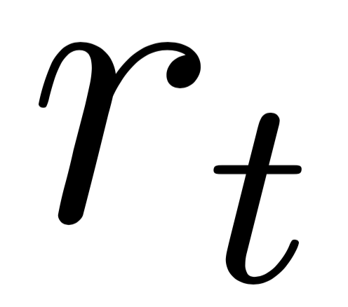
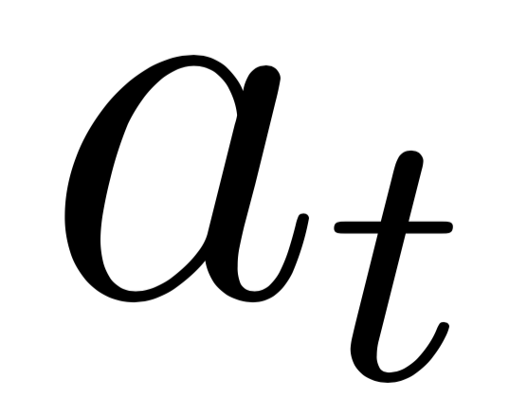
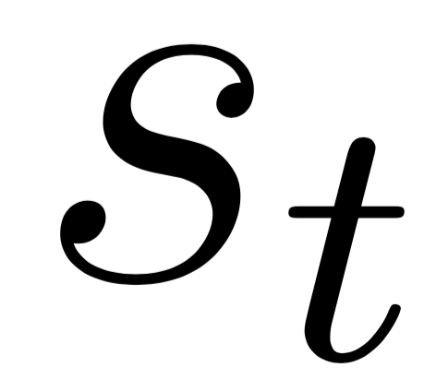
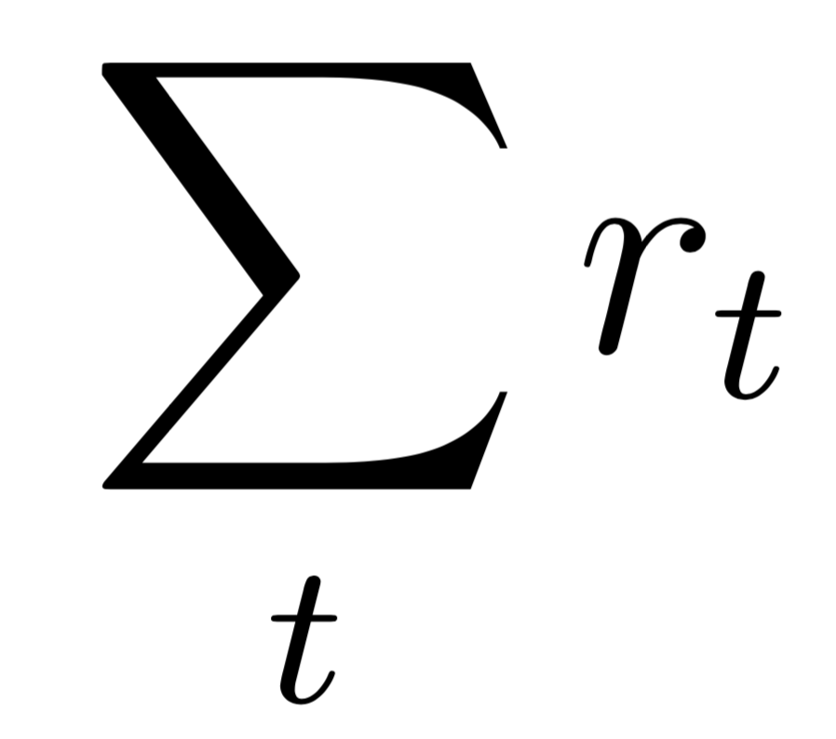
Reinforcement Learning
Reward
Agent
Environment
Take action
Observe state
Goal: maximize the cumulative reward
Notes:
[…], using Reinforcement Learning.
Let me first give you an overview of reinforcement learning
Reinforcement Learning poses a general framework, where an agent interacts with an environment. At each time step, the agent observes a state from the environment, and takes an action. As a feedback, the environment returns the agent a reward signal, indicating how good the action is. The goal of the learning agent is to maximize the total reward in the environment.
-
[…] = To overcome the issues with today's fixed ABR algorithms, we turn to design a general purposed learning algorithm. Specifically, we are proposing to learn bitrate adaptation policies, by interacting with the video streaming environment in actual network conditions

Slide 7

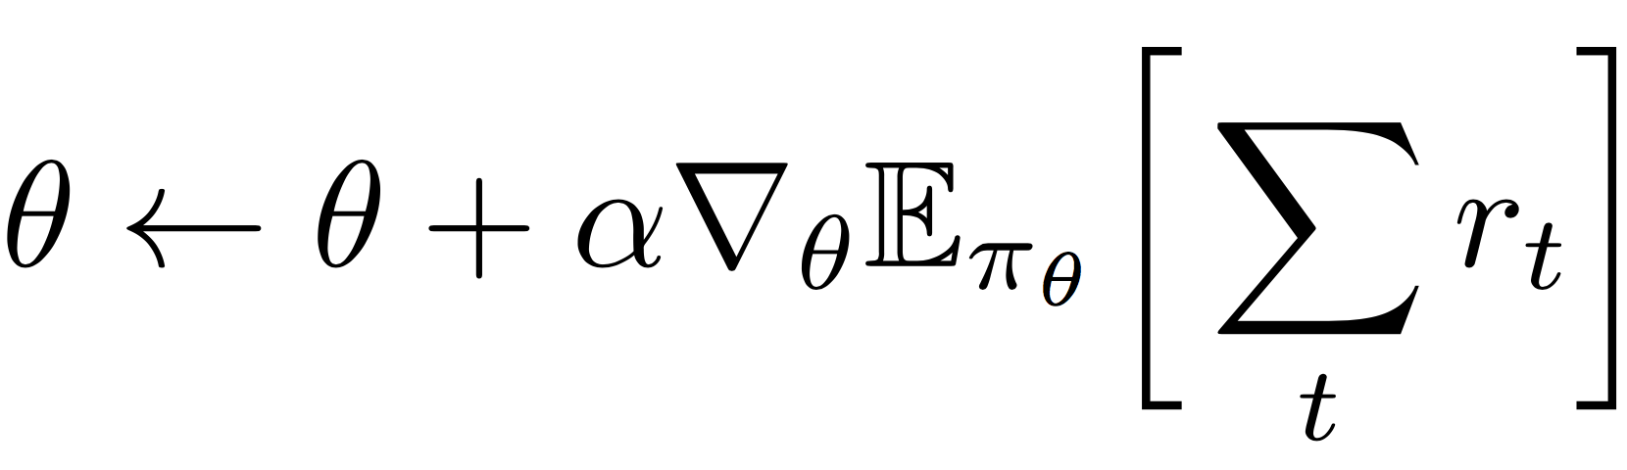
How to Train the ABR Agent
ABR agent
policy
π_{θ}(s, a)
Neural Network
240P
state
Observe state s
480P
Take action a
next bitrate
720P
1080P
parameter θ
Collect experience data: trajectory of [state, action, reward]
Training:
estimate from
empirical data
Notes:
Now how do we train the neural network? Or in other words, how do we improve the bitrate adaptation policy?
[click]
The key idea is you run the system, you collect experience data, which is the trajectory of state, action and reward: what state did I visited, what action did I take and what reward did I receive.
To train, we basically use gradient descent to move the neural network parameters in a direction that can increase the reward.
[click]
Remember, the goal is to maximize total reward, we can take the gradient of the total reward and move the neural net parameter in the direction of the gradient.
[click] In practice, the gradient of total reward can be estimated empirically from the experience data.
The details of this math and the specific algorithm is in the paper, but the key take away is that we train the neural network essentially through a guided process of trial and error, exploring different actions and learning what actions provide better reward.

Slide 8
What Pensieve is good at
Learn the dynamics directly from experience
Optimize the high level QoE objective end-to-end
Extract control rules from raw high-dimensional signals
Notes:
At a high level, there are some nice properties of this Reinforcement Learning framework that fit exactly for the bitrate adaptation problem.
First, unlike the heuristics based methods, the learning approach can adapt faithfully to the underlining characteristics of the network in a data-driven way. For example, after seeing many many examples in the cellular network, it will figure out quantitatively how much buffer it needs to build to cope for uncertainty in the nature of the network.
Also, the framework allows you to optimize for a high level QoE metric end-to-end, without having to explicitly model how it is impacted by low level decisions. We can optimize for any arbitrary QoE metric as long as we can represent it through the reward signal.
In addition, you can learn an ABR algorithm that takes as input raw high-dimensional signals, like the sequence of throughput samples, and extract useful information out of it. That's from the power of the underlining neural network.

Slide 9
Summary
Pensieve uses Reinforcement Learning to generate ABR algorithms
Pensieve optimizes different network conditions through experience
Pensieve outperforms existing approaches across a wide range of network environments and QoE preferences
Policies generated by Pensieve have strong ability to generalize
http://web.mit.edu/pensieve/
Notes:
As a summray, Pensieve is a system that uses reinforcement learning to genreate ABR algorithms. It optimizes for different network conditions through experience. Pensieve outperforms state-of-the-art schemes in a wide range of settings. And it generalizes well even for the network conditions on which it is not explicitly trained.
More information and the open-sourced code can be found in our website.
With that, thank you and I’m happy to take questions

